Slide 1
Fuzzy Logic
Rules
Dr Samar Hesham
Department of Computer Science Faculty of Computers and Artificial Intelligence
Cairo University
Egypt

Slide 2
Operations of Fuzzy Sets
Traditional set operations:
Not A
A
B AA
Complement
Containment
A B
A B
Intersection
Union

Slide 3
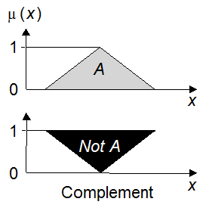
Operations of Fuzzy Sets
Complement
Crisp Sets: Who does not belong to the set?
Fuzzy Sets: How much do elements not belong to the set?
Example: if we have the set of tall men, its complement is the set of NOT tall men.
If A is the fuzzy set, its complement ¬A can be found as follows:
μ¬_{A}(x) = 1 − μ_{A}(x)

Slide 4
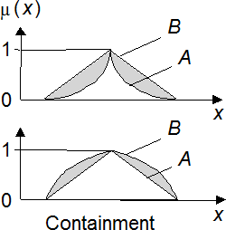
Operations of Fuzzy Sets
Containment
Crisp Sets: Which sets belong to which other sets?
Fuzzy Sets: Which sets belong to other sets?
Example: very tall men is a subset of tall men.
Elements of the fuzzy subset have smaller memberships in it than in the
larger set.

Slide 5
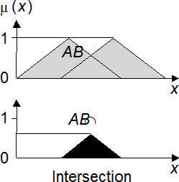
Operations of Fuzzy Sets
Intersection
Crisp Sets: Which element belongs to both sets?
Fuzzy Sets: How much of the element is in both sets? an element may partly belong to both sets with different memberships.
Fuzzy intersection is the lower membership in both sets of each element.
The fuzzy intersection of two fuzzy sets A and B on universe of discourse X:
μ_{A}∩_{B}(x) = min [μ_{A} (x), μ_{B} (x)] = μ_{A} (x) ∩ μ_{B}(x), where x∈X

Slide 6
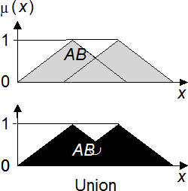
Operations of Fuzzy Sets
Union
Crisp Sets: Which element belongs to either set?
Fuzzy Sets: How much of the element is in either set?
Fuzzy Union is the reverse of the intersection, so the union is the largest membership value of the element in either set.
The fuzzy operation for forming the union of two fuzzy sets A and B on universe X can be given as:
μ_{A}∪_{B}(x) = max [μ_{A} (x), μ_{B}(x)] = μ_{A} (x) ∪ μ_{B}(x)
where x∈X

Slide 7
Fuzzy Logic
How do we use fuzzy membership functions in predicate logic?
Fuzzy logic Connectives:
Fuzzy Conjunction(Intersection), ∧
Fuzzy Disjunction(union), ∨
Operate on degrees of membership in fuzzy sets

Slide 8
Fuzzy Disjunction
A∨B max(A, B)
A∨B = C "Quality C is the disjunction of Quality A and B"
A B
1 1
0.75
0.375
0 0
(A∨B = C) ⇒ (C = 0.75)

Slide 9
Fuzzy Conjunction
A∧B min(A, B)
A∧B = C "Quality C is the conjunction of Quality A and B"
A B
1 1
0.75
0.375
0 0
(A∧B = C) ⇒ (C = 0.375)

Slide 10
Example: Fuzzy Conjunction
Calculate A∧B given that A is .4 and B is 20
A B
1 1
0
0
.1 .2 .3 .4 .5 .6 .7 .8 .9
1 5 10 15 20 25 30 35 40

Slide 11
Example: Fuzzy Conjunction
Calculate A∧B given that A is .4 and B is 20
A B
1 1
0
0
.1 .2 .3 .4 .5 .6 .7 .8 .9 1 5 10 15 20 25 30 35 40
Determine degrees of membership:

Slide 12
Example: Fuzzy Conjunction
Calculate A∧B given that A is .4 and B is 20
A B
1 1
0.7
0
0
.1 .2 .3 .4 .5 .6 .7 .8 .9 1 5 10 15 20 25 30 35 40
Determine degrees of membership: A = 0.7

Slide 13
Example: Fuzzy Conjunction
Calculate A∧B given that A is .4 and B is 20
A B
1
1
0.9
0.7
0
0
.1 .2 .3 .4 .5 .6 .7 .8 .9 1 5 10 15 20 25 30 35 40
Determine degrees of membership: A = 0.7 B = 0.9

Slide 14
Example: Fuzzy Conjunction
Calculate A∧B given that A is .4 and B is 20
A B
1
1
0.9
0.7
0
0
.1 .2 .3 .4 .5 .6 .7 .8 .9 1 5 10 15 20 25 30 35 40
Determine degrees of membership: A = 0.7 B = 0.9
Apply Fuzzy AND
A∧B = min(A, B) = 0.7

Slide 15
What can we do now?
What should be done is summarized into
three main stages
Fuzzification
Membership functions used to graphically describe a situation
Evaluation of Rules (Inference)
Application of the fuzzy logic rules
De-fuzzification
Obtaining the crisp results

Slide 16
Inputs: Temperature
Temp: {Freezing, Cool, Warm, Hot}
1
Freezing Cool Warm Hot
0
50 70
Temp. (F°)
10
30
90
110

Slide 17
Inputs: Temperature, Cloud Cover
Temp: {Freezing, Cool, Warm, Hot}
1
Freezing Cool Warm Hot
0
50 70
Temp. (F°)
10
30
90
110
Cover: {Sunny, Partly, Overcast}
1
Sunny Partly Cloudy
Overcast
0
40 60
Cloud Cover (%)
0
20
80
100

Slide 18
Output: Speed
Speed: {Slow, Fast}
1
Slow
Fast
0
50 75
Speed (mph)
0
25
100

Slide 19
Fuzzy Rules
A fuzzy rule can be defined as a conditional statement in the form:
IF
THEN
x is A
y is B
where x and y are linguistic variables; and A and B
are linguistic values determined by fuzzy sets on the universe of discourses X and Y, respectively.
If antecedents (x) is true to some degree of membership, then consequent (y) is also true to that same degree.
EX:
IF speed is slow
THEN stopping_distance is short

Slide 20
Fuzzy Rules
A fuzzy rule can have multiple antecedents, for example:
IF AND AND THEN
project_duration is long project_staffing is large project_funding is inadequate risk is high
The consequent of a fuzzy rule can also include multiple parts, for instance:
IF temperature is hot
THEN hot_water is reduced;
cold_water is increased

Slide 21
Fuzzy Rules
If it's Sunny and Warm, drive Fast
Sunny(Cover)∧Warm(Temp)⇒ Fast(Speed)
If it's Cloudy and Cool, drive Slow
Cloudy(Cover)∧Cool(Temp)⇒ Slow(Speed)
Driving Speed is the combination of output of these rules...

Slide 22
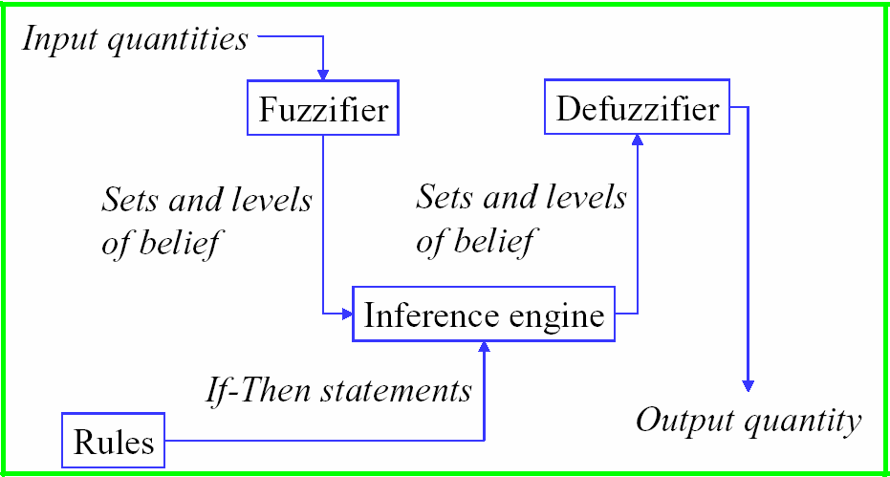
Fuzzy Control Components

Slide 23
How it work?
Crisp data
Fuzzifier Member 90% hot
10% cold
Inputs converted to degrees of membership of fuzzy sets.
Fuzzy rules
IF 90% hot THEN 80% open
IF 10% cold THEN 20% closed
Fuzzy rules applied to get new sets of members.
Fuzzy output set 80% open, 20% closed
These sets are then converted back to real numbers.
Defuzzifier
Crisp data
9/27/2022
25

Slide 24
Steps
determining a set of fuzzy rules
fuzzifying the inputs using the input membership functions.
combining the fuzzified inputs according to the fuzzy rules to establish a rule strength,
finding the consequence of the rule by combining the rule strength and the output membership function.
combining the consequences to get an output distribution.
defuzzifying the output distribution.

Slide 25
Example: Speed Calculation
How fast will I go if it is
– 65 F°
– 25 % Cloud Cover ?

Slide 26
Fuzzification:
Calculate Input Membership Levels
65 F° ⇒ Cool = 0.4, Warm= 0.7
1
Freezing
Cool
Warm
Hot
0
50 70
Temp. (F°)
10
30
90
110

Slide 27
Fuzzification:
Calculate Input Membership Levels
65 F° ⇒ Cool = 0.4, Warm= 0.7
1
Freezing Cool Warm Hot
0
10 30 50 70 90 110
Temp. (F°)
25% Cover ⇒Sunny = 0.8, Cloudy = 0.2
1
Sunny
Partly Cloudy
Overcast
0
40 60
Cloud Cover (%)
0
20
80
100

Slide 28
...Calculating...
If it's Sunny and Warm, drive Fast
Sunny(Cover)∧Warm(Temp)⇒Fast(Speed)
0.8 ∧ 0.7 = 0.7
⇒ Fast = 0.7
If it's Cloudy and Cool, drive Slow
Cloudy(Cover)∧Cool(Temp)⇒Slow(Speed)
0.2 ∧ 0.4 = 0.2
⇒ Slow = 0.2

Slide 29
Defuzzification: Constructing the Output
Speed is 20% Slow and 70% Fast
1
Slow Fast
0
50 75
Speed (mph)
0
25
100
Find centroids: Location where membership is 100%

Slide 30
Defuzzification: Constructing the Output
Speed is 20% Slow and 70% Fast
1
Slow Fast
0
50 75
Speed (mph)
0
25
100
Find centroids: Location where membership is 100%

Slide 31
Defuzzification: Constructing the Output
Speed is 20% Slow and 70% Fast
1
Slow Fast
0
0 25 50 75 100
Speed (mph)
= weighted average mean
= (0.2*25+...
Speed

Slide 32
Defuzzification: Constructing the Output
Speed is 20% Slow and 70% Fast
1
Slow Fast
0
0 25 50 75 100
Speed (mph)
= weighted mean
= (0.2*25+0.7*75)/(0.2+0.7)
= 63.8 mph
Speed

Slide 33
Hybrid with other techniques
Complicated systems may require several iterations to find a set of rules resulting in a stable system.
It’s often helpful to get other AI techniques to generate the membership functions – e.g. Neural Nets and Genetic Algorithms.
Combining Neural Networks with fuzzy logic reduces time to establish rules by analyzing clusters of data.
9/27/2022
39

